Slide 1


Edmond Kinnard
US Chronic Diseases

Slide 2

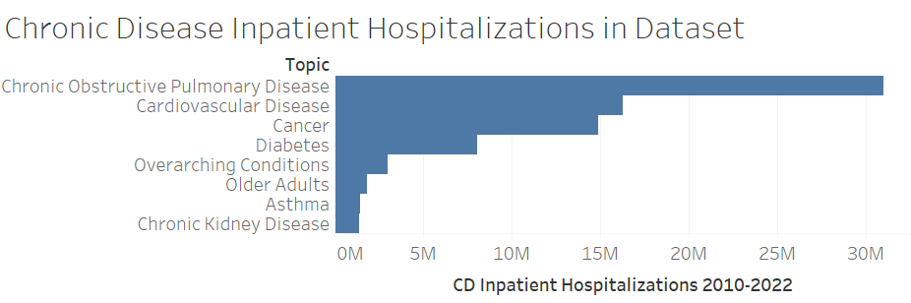
Based on Inpatient Hospitalizations

Slide 3
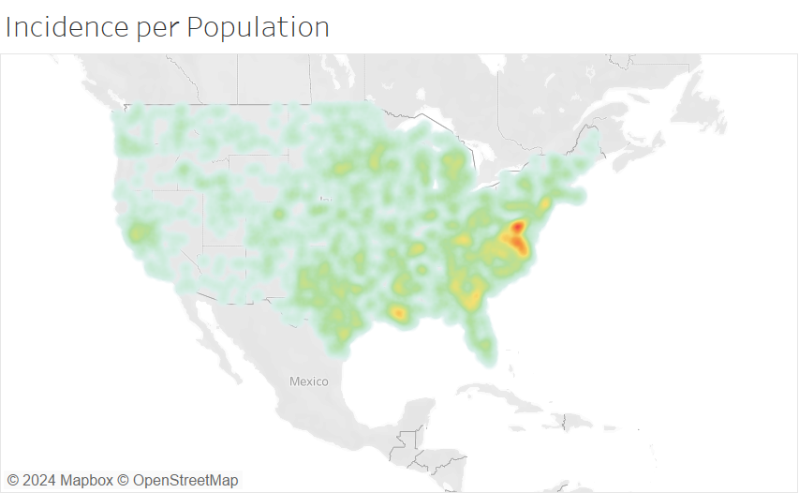
Where are the diseases?
Concentrations:
Washington DC / Virginia
Louisiana
Southeast

Slide 4
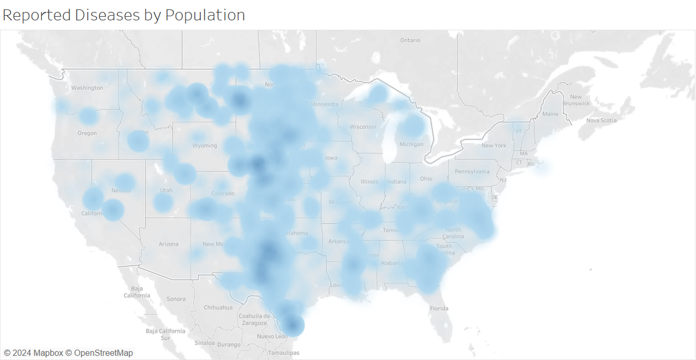
Where are all the diseases by population?
Concentration:
South Texas through North Dakota
**Incidence divided by local population count

Slide 5
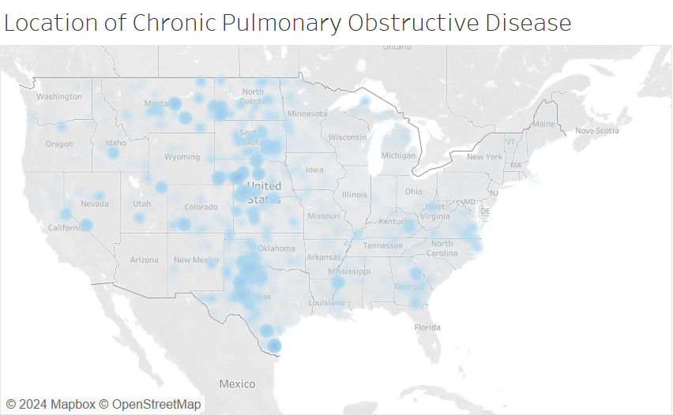
Where i Chronic Pulmonary Obstructive Disease by Population
Concentration:
South Texas through North Dakota
**Incidence divided by local population count

Slide 6
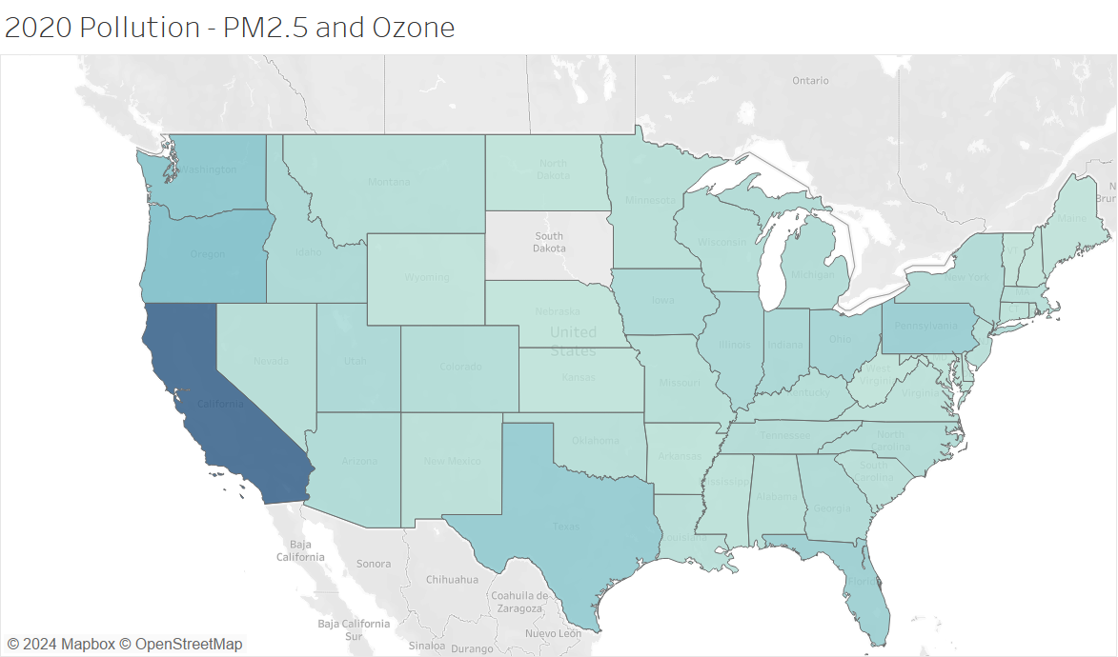
Where is the air pollution?
California
Washington
Oregon

Slide 7
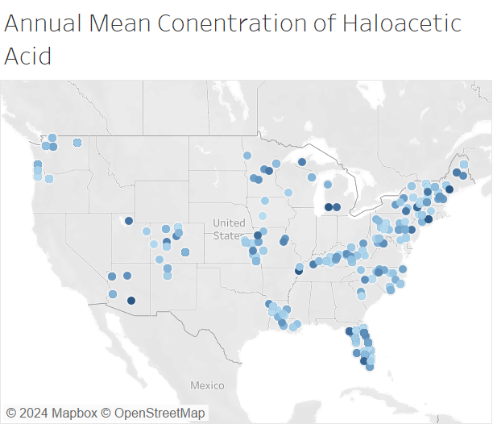
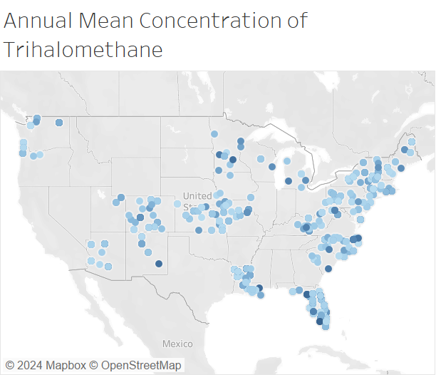
Where is the Water Pollution?
Haloacetic Acid
Trihalomethane

Slide 8
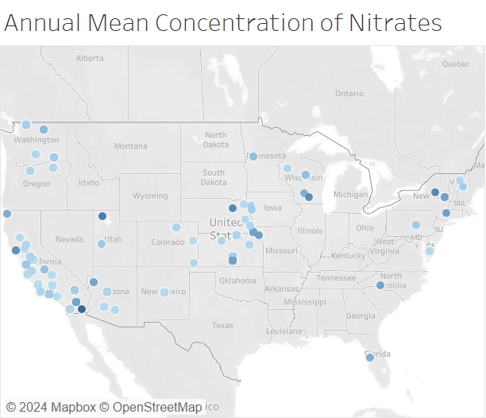
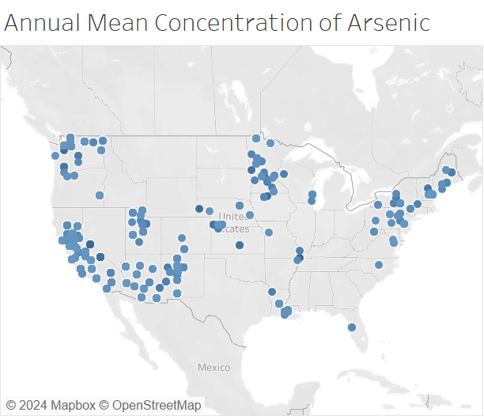
Where is the Water Pollution?
Nitrates
Arsenic

Slide 9

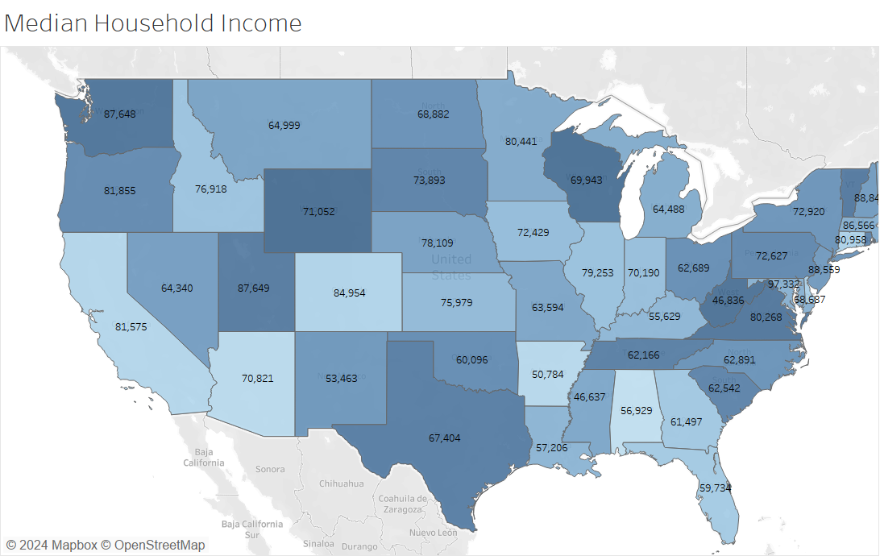
Where Is the Money?

Slide 10

In Conclusion:
Chronic diseases are complicated

